Slide 1
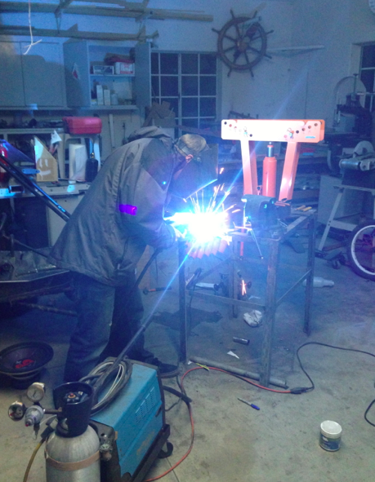
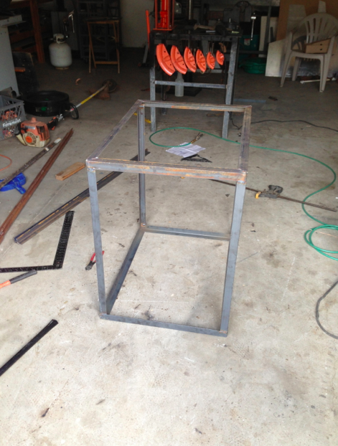
Sleek aluminum design with mild steel angle iron frame.
Welding with a Mig welder(Metal Inert Gas)
Progression of the Frame

